Slide 1
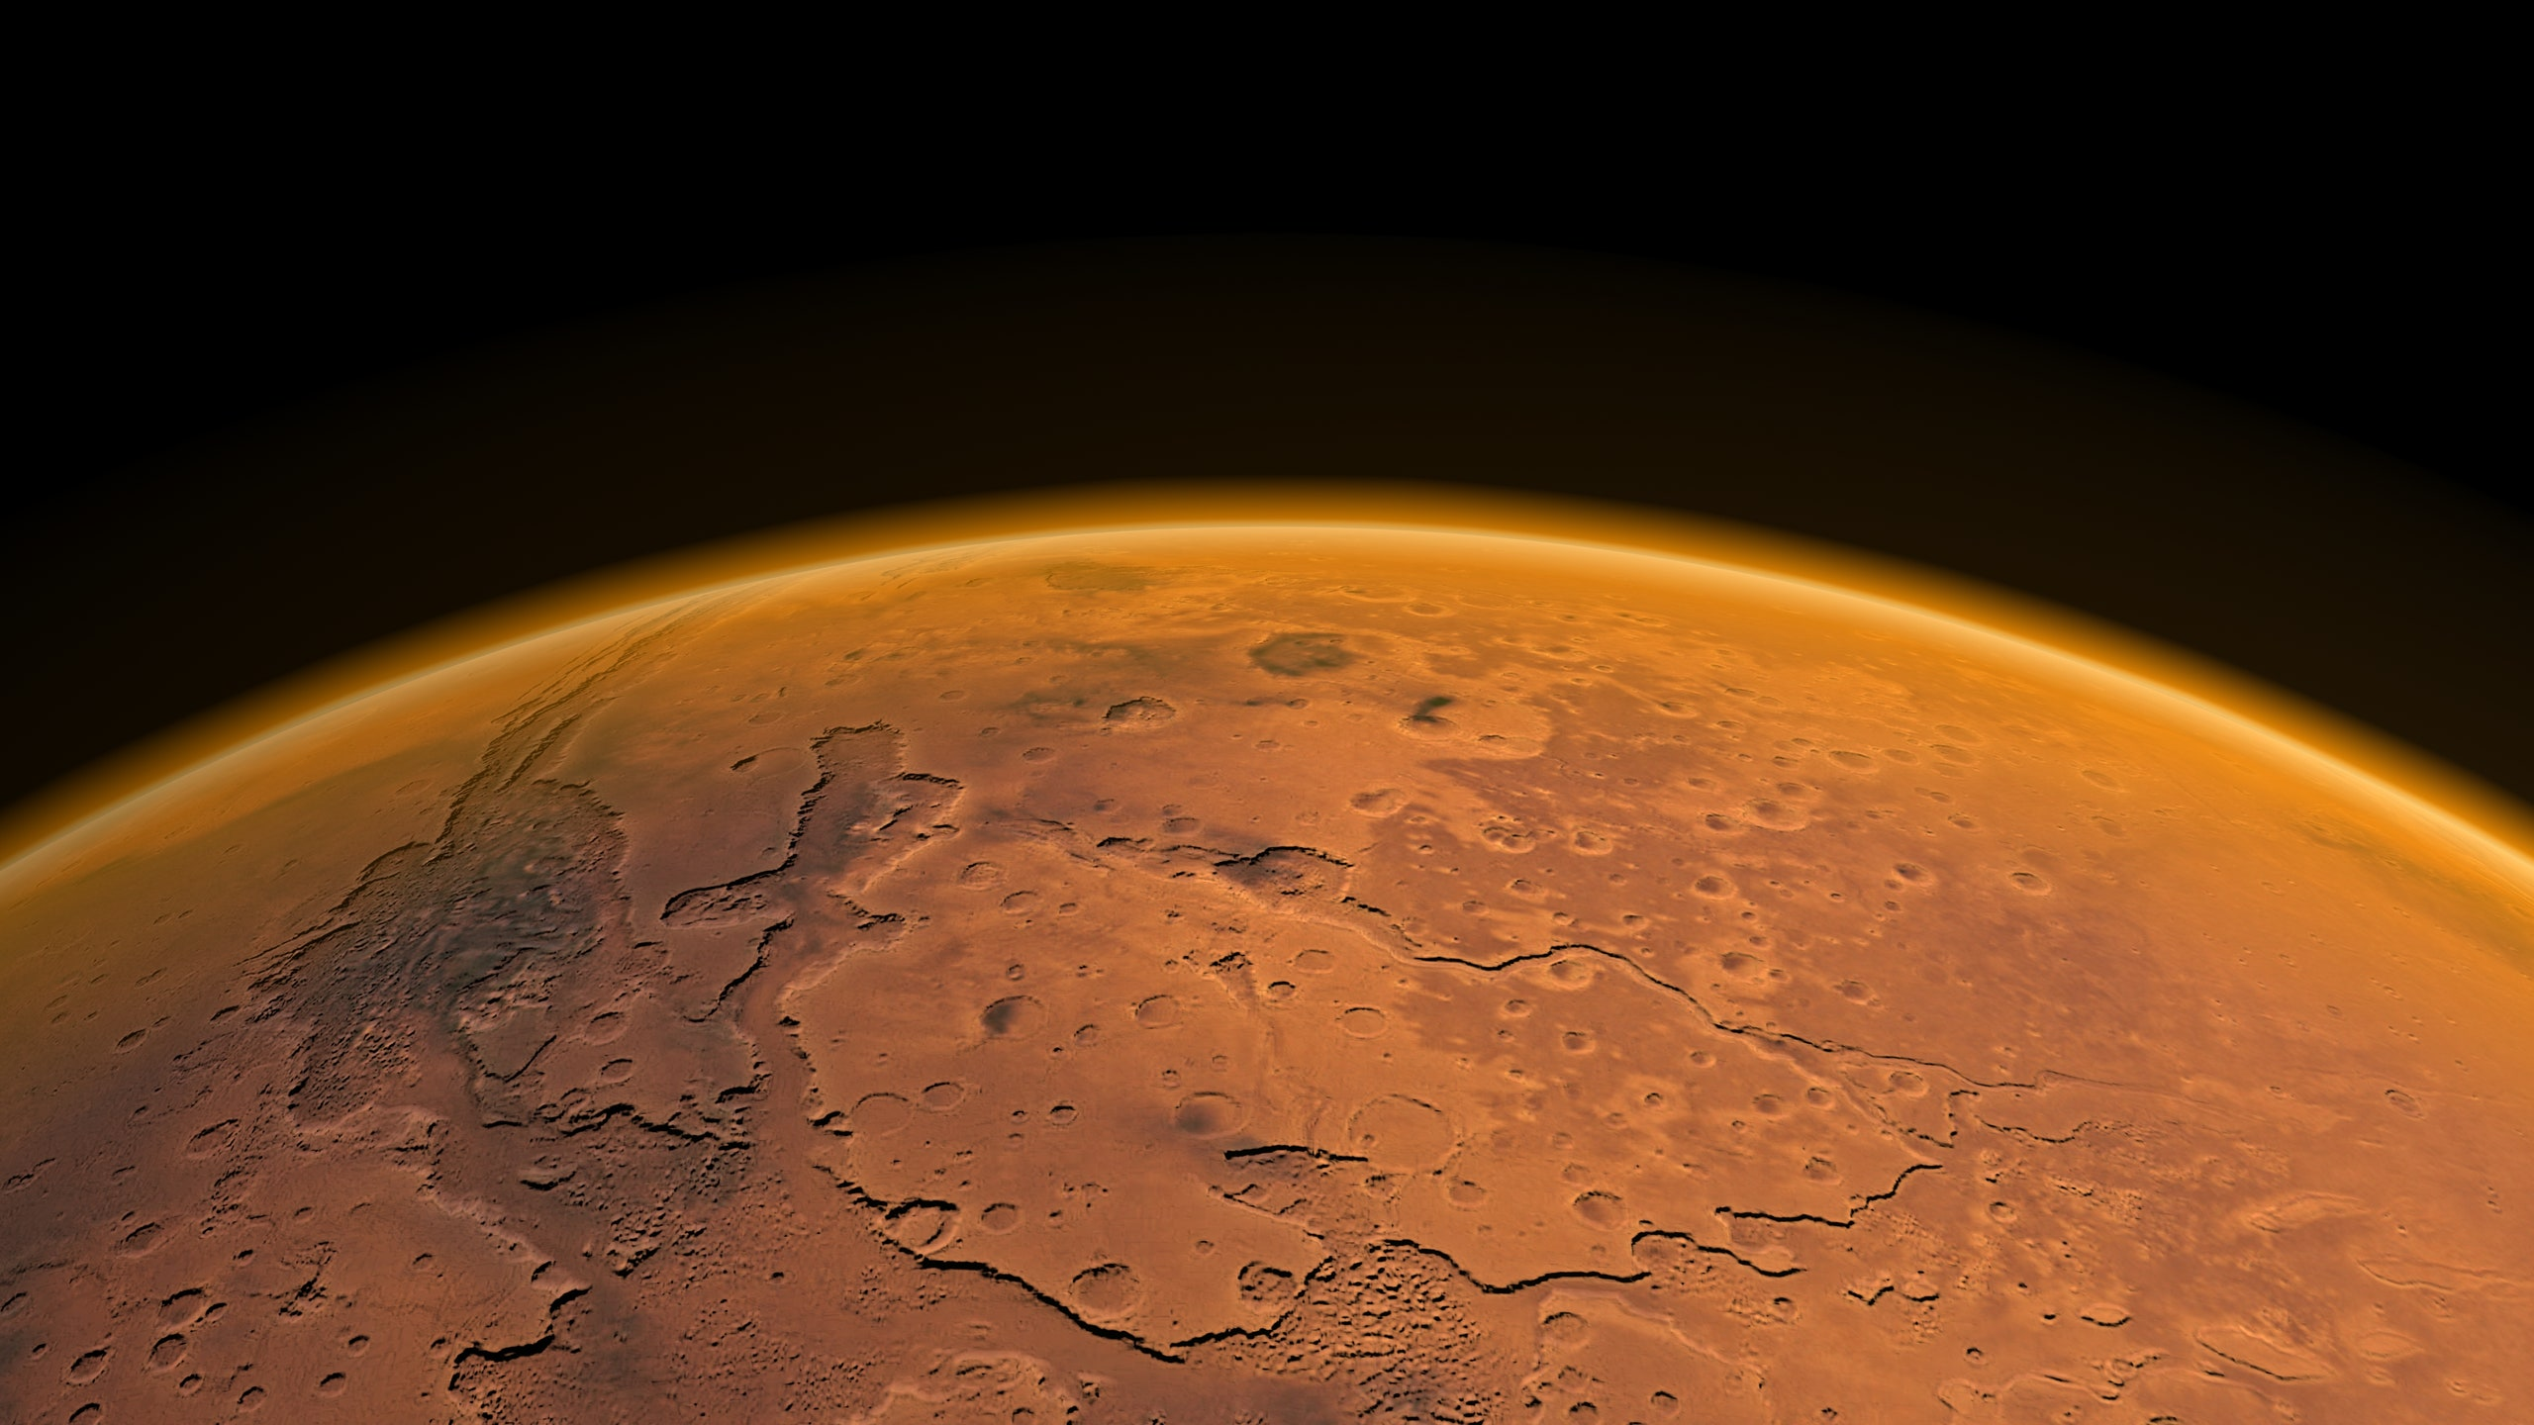



Mapping Martian Crustal Magnetic Anomalies
Travis Matlock
Advisor: Lon Hood

Slide 2
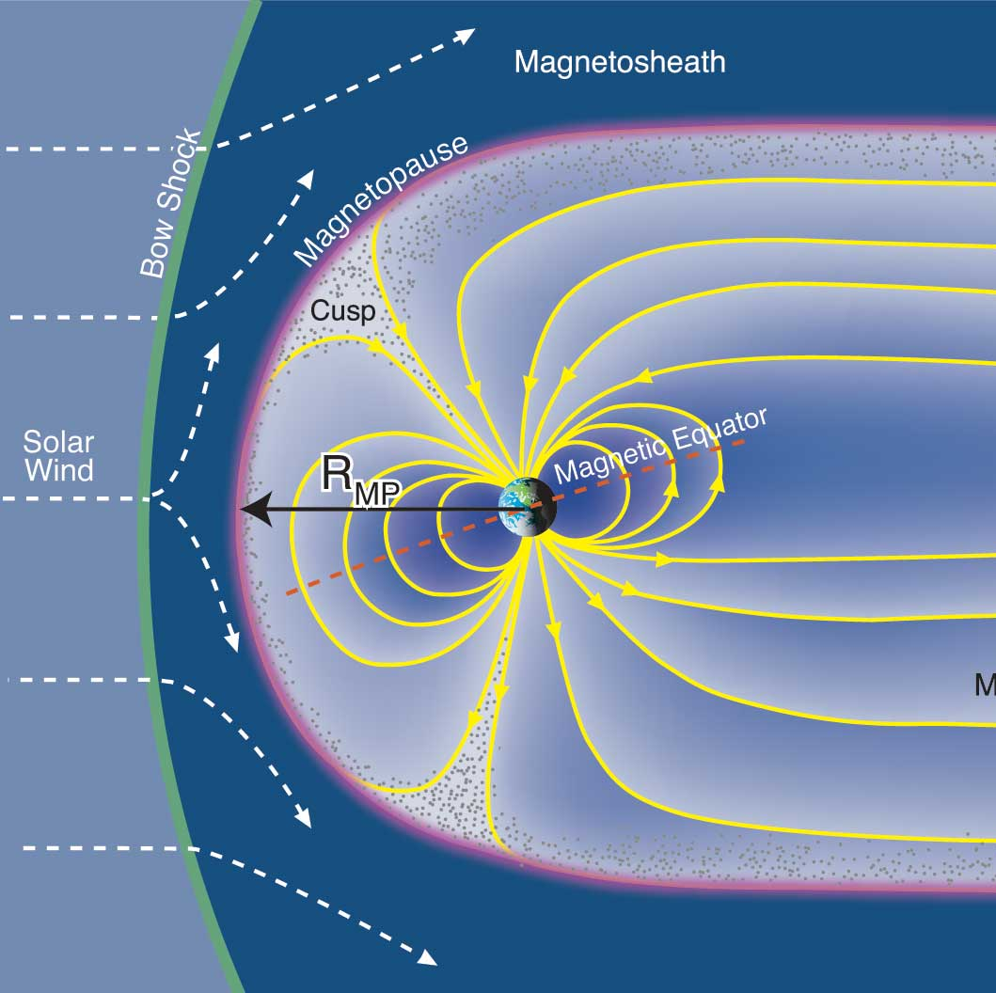

Magnetic Dynamos
Requires rotating, convective, conductive fluid interior
Deflects solar wind ions
The Sun, gas & ice giants, and Earth all host global magnetic fields
In the 90s, Mars’ magnetic field strength and nature were unknown
Credit: Fran Bagenal & Steve Bartlett

Slide 3
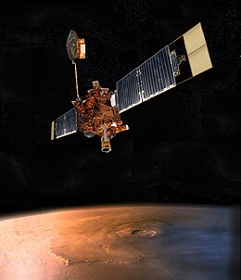
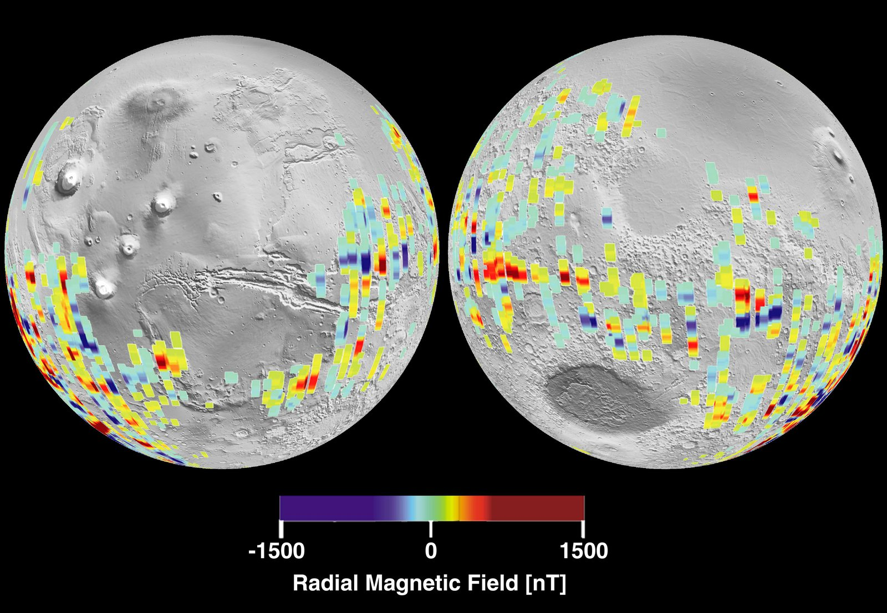
Mars Global Surveyor
Arrived in 1997
Equipped with magnetometer and electron reflectometer
Measured a patchy and variable magnetic field
Represents a “crustal” magnetic field
Credit: Nasa Jet Propulsion Laboratory

Slide 4
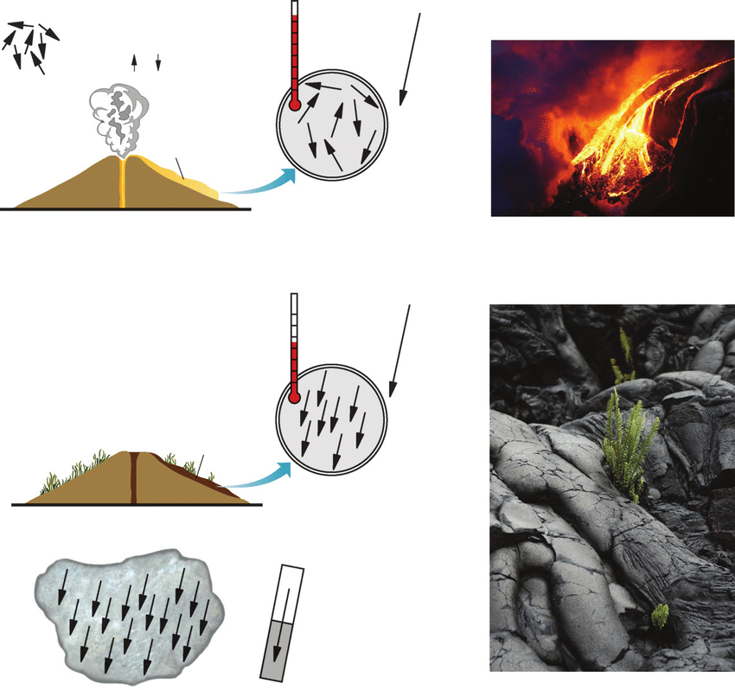
Remanent Magnetism
Iron atoms in erupting lava
Water can supply oxidation to create ferromagnetic iron oxides (hematite, etc.)
These iron oxides stay permanently magnetized after removing external magnetic field – remanence
Credit: Andrew Roberts & Gillian Turner

Slide 5
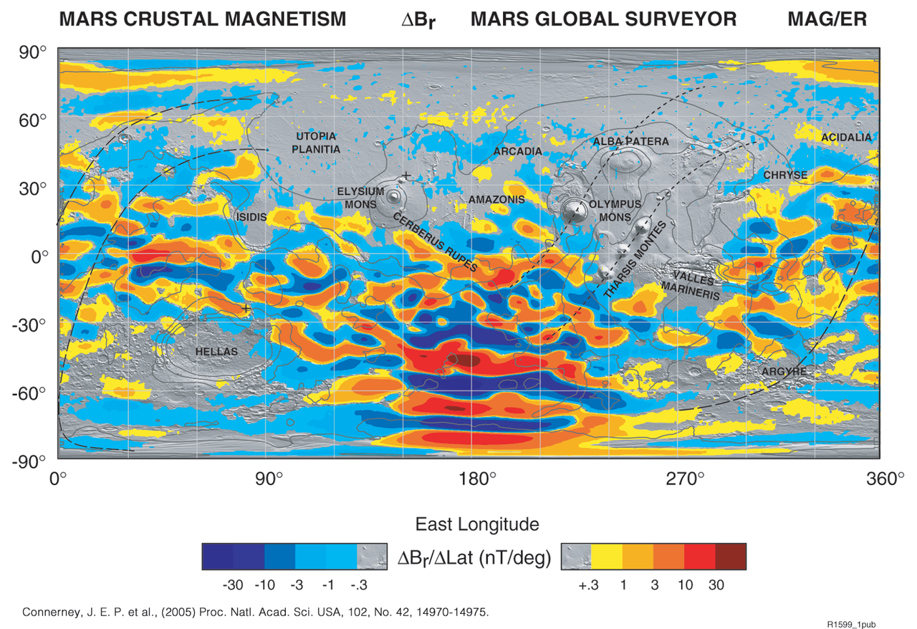
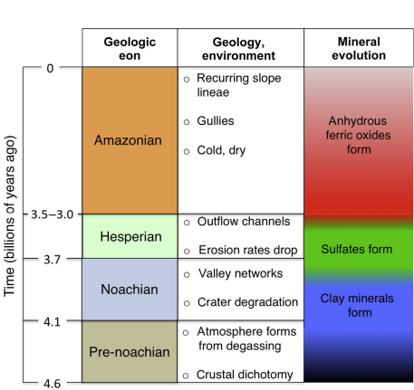
Back to MGS…
Lack of signatures over young volcanoes, old basins
Leads to dynamo cessation date of 4.1 billion years ago
Credit: David Catling, UW 2014

Slide 6
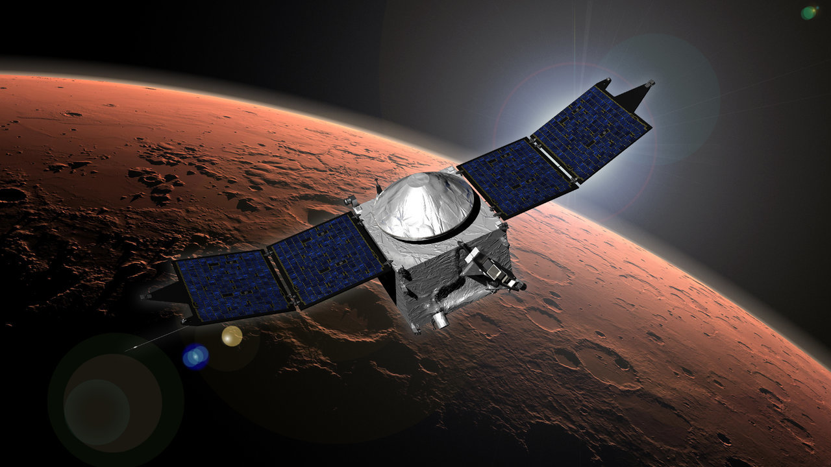
MAVEN
Mars Atmosphere & Volatile EvolutioN
Orbited at lower altitudes than MGS
Equipped with magnetometer
Credit: NASA

Slide 7
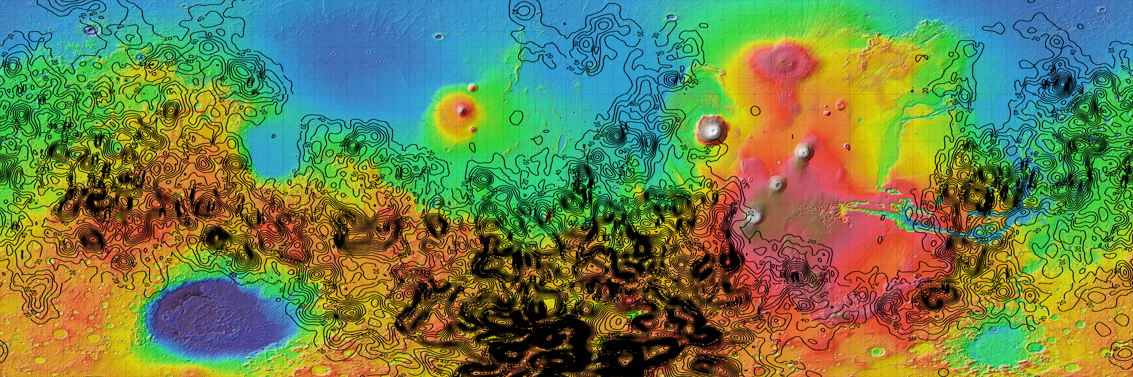
Our (Nearly) Global Map
Modeled using an array of dipoles 10 km deep (equivalent source dipole method)
Modeled at altitude of 130 km, 0.5° resolution for latitudes 60°S - 60°N
Mosaic of sixteen 90° x 30° regions

Slide 8
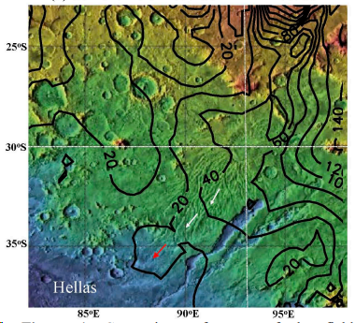
Hadriaca Patera
Ancient volcano with deposits which have been eroded by water
Magnetic field extended in direction of flow
Not visible at lower resolution
Post-Hellas dynamo?
Presented by Lon Hood at 55th Lunar and Planetary Science Conference
Credit: Hood et al. 2024

Slide 9
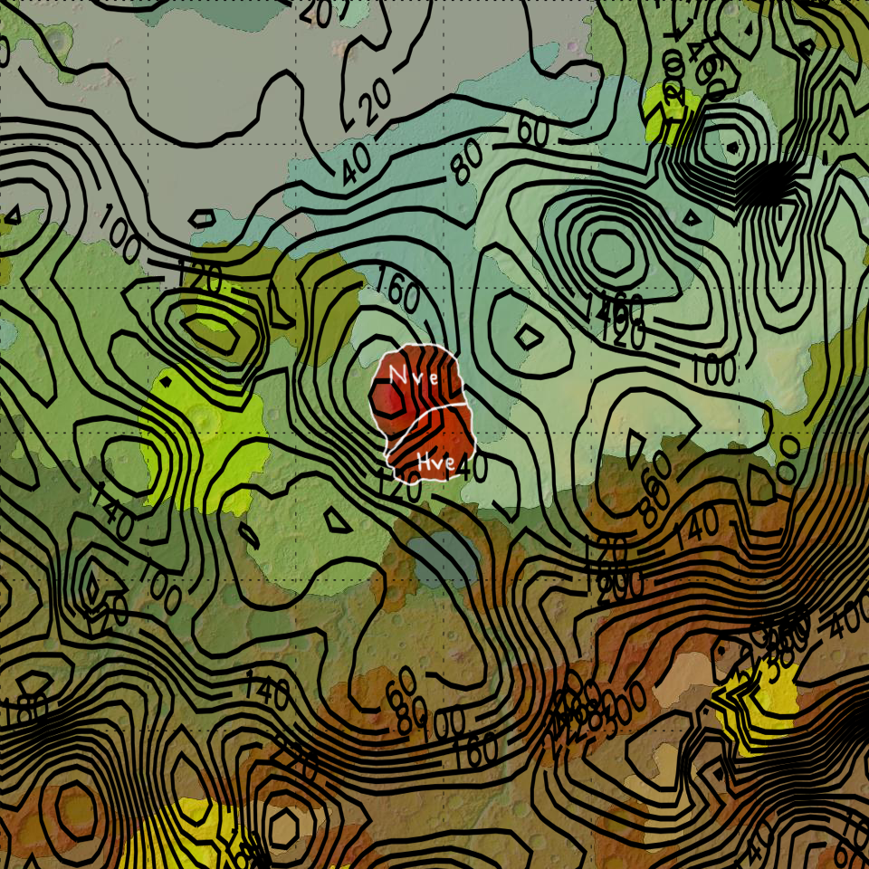
Apollinaris Mons
Magnetic anomaly is offset from volcano
Following Tanaka’s 2014 geological unit map, anomaly aligns with Noachian edifice, is diminished over Hesperian edifice

Slide 10
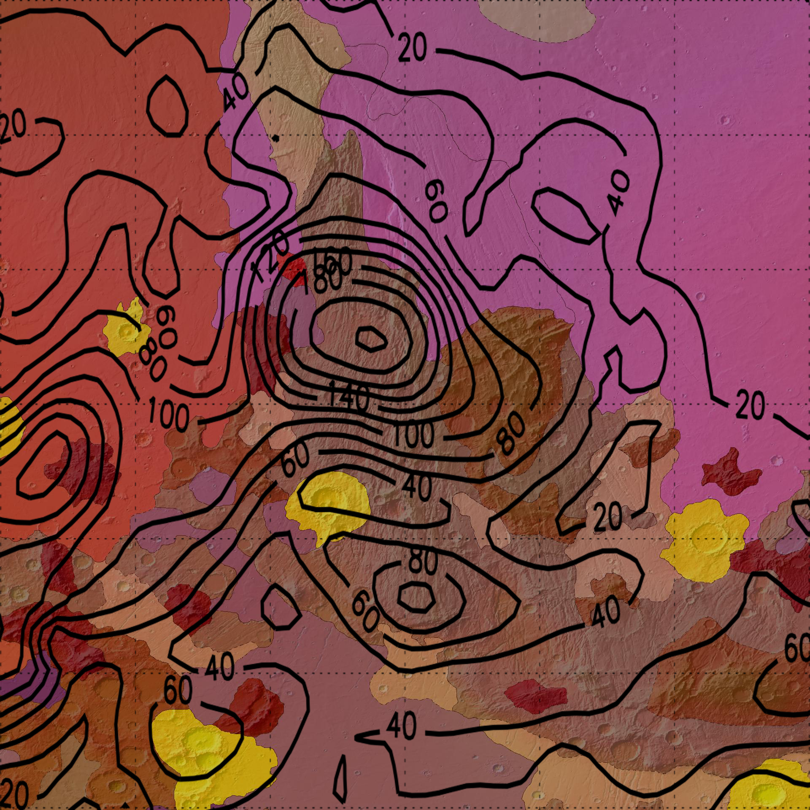
Claritas Fossae
First clear association of this anomaly with the topographic and geologic feature
Strong evidence of correlation between magnetic anomalies and surface features

Slide 11
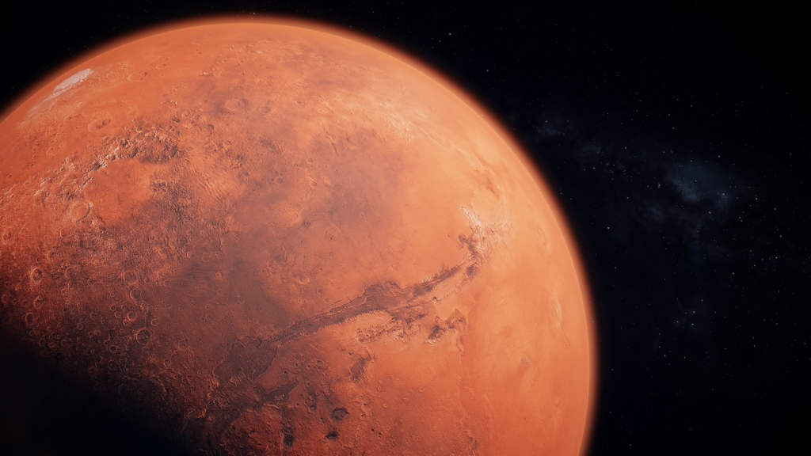
Thank you
Acknowledgments:
My advisor, Lon Hood
The Arizona Space Grant Consortium
NASA’s Mars Data Analysis Program

